Slide 1
Safety Act Unit 5

Slide 2
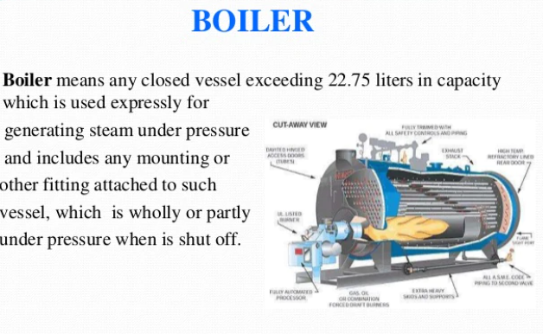
The Indian Boilers Act-1923
The Indian Boilers Act-1923 was enacted with the objective to provide mainly for the safety of life and Property of persons from the danger of explosions of steam boilers and for achieving uniformity in registration and inspection during operation and maintenance of boilers in India.

Slide 3
The Electricity (Supply) Act, 1948
Before Electricity Act, 2003, the Indian Electricity sector was guided by The Indian Electricity Act, 1910 and The Electricity (Supply) Act, 1948 and the Electricity Regulatory Commission Act, 1998. The generation, distribution and transmission were carried out mainly by the State Electricity Boards in various States. Due to politico-economic situation, the cross-subsidies reached at an unsustainable level. For the purpose of distancing state governments from tariff determination, The Electricity Regulatory Commissions Act was enacted in 1998. So as to reform electricity sector further by participation of private sector and to bring in competition, Electricity Act was enacted in 2003.

Slide 4
With effect from 2 June 2003 India has adopted a new legislation called the Electricity Act 2003, to replace some age-old existing legislation operating in the country. The new act consolidates the position for existing laws and aims to provide for measures conducive to the development of electricity industry in the country. The act has attempted to address certain issues that have slowed down the reform process in the country and consequently has generated new hopes for the electricity industry. This paper reviews the Electricity Act 2003, to highlight how the new features are different from the existing legal provisions and whether these measures have economic rationale.
An act to consolidate the laws relating to generation, transmission, distribution, trading and use of electricity for taking measures conducive to development of electricity industry, promoting competition therein, protecting interest of consumers and supply of electricity to all areas, rationalisation of electricity tariff, ensuring transparent policies regarding subsidies, promotion of efficient and environmentally benign policies, constitution of Central Electricity Authority Regulatory Commissions and establishments of Appellate Tribunal for matters therewith or incident thereto.

Slide 5

Explosive Rules, 1983
Explosives Rules deal with condenced explosives like high explosives
Mines Act, 1952
The Mines Act, 1952 was enacted to enforce for measures of safety and welfare of labourers working in coal, metallic, ferrous and oil mines.

Slide 6
Work Hours, Intervals and Night Shift
The Act prohibits employment of any women in any part of a mine which is below-ground and on ground, except between the hours 6 a.m. and 7 p.m. It also provides that every women employed in a mine above ground shall be allowed break of not less than 11 hours between the end of day work and the commencement of the next day of work . (Section 46)
Safety Measures
The Mines Act, 1952 provides for safety measures for labourers working in coal, metallic, ferrous, and oil mines while working with shafts, opencast workings, conveyors or aerial ropeways, etc. (Section 57)
Petroleum Act, 1934
PETROLEUM ACT
The Petroleum Act, 1934, is an Act to consolidate and amend the law relating to the import, transport, storage, production, refining and blending of petroleum. Petroleum may be any liquid hydrocarbon or mixture of hydrocarbons, and inflammable mixture (liquid, viscous or solid) containing any hydrocarbon, and includes natural gas and refinery gas.

Slide 7

Environment Protection Act, 1986
Environment Protection Act, 1986 is an Act of the Parliament of India. In the wake of the Bhopal Tragedy, the Government of India enacted the Environment Protection Act of 1986 under Article 253 of the Constitution.

Slide 8
In this Act, unless the context otherwise requires,--
"environment" includes water, air and land and the inter- relationship which exists among and between water, air and land, and human beings, other living creatures, plants, micro-organism and property;
(b) "environmental pollutant" means any solid, liquid or gaseous substance present in such concentration as may be, or tend to be, injurious to environment;
(c) "environmental pollution" means the presence in the environment of any environmental pollutant;
(d) "handling", in relation to any substance, means the manufacture, processing, treatment, package, storage, transportation, use, collection, destruction, conversion, offering for sale, transfer or the like of such substance;
(e) "hazardous substance" means any substance or preparation which, by reason of its chemical or physico-chemical properties or handling, is liable to cause harm to human beings, other living creatures, plant, micro-organism, property or the environment;
(f) "occupier", in relation to any factory or premises, means a person who has, control over the affairs of the factory or the premises and includes in relation to any substance, the person in possession of the substance;
(g) "prescribed" means prescribed by rules made under this Act.

